Slide 1
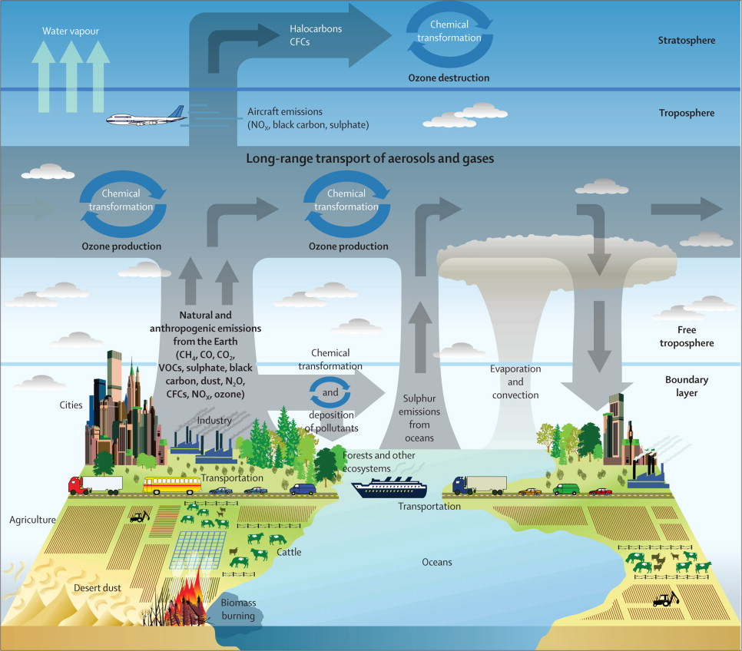
ATM 505
Atmospheric Chemistry
Jie Zhang
ASRC-Office ETEC 320I
jzhang35@albany.edu
Source: wikiwand

Slide 2
Office Hours
By appointment or knock my door– individual or group. Either zoom or in-person.
Email – I will respond within 24 hours, and often right away.
Meetings – I can meet with individuals or groups at mutually agreeable times. (Set up by email or during class.)

Slide 3
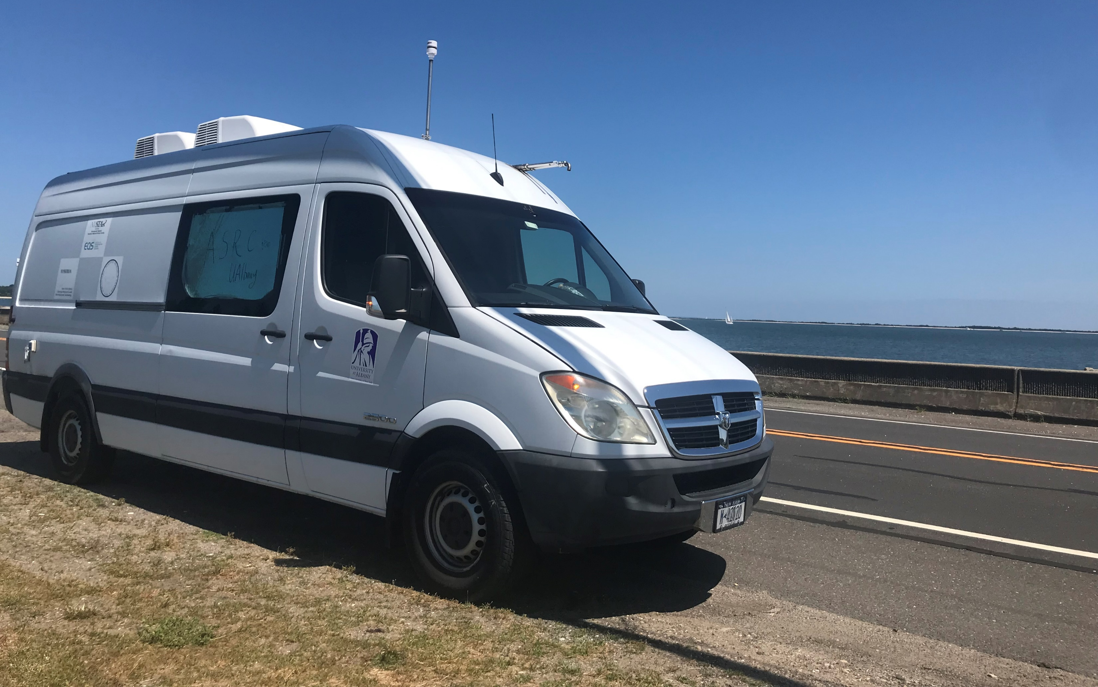
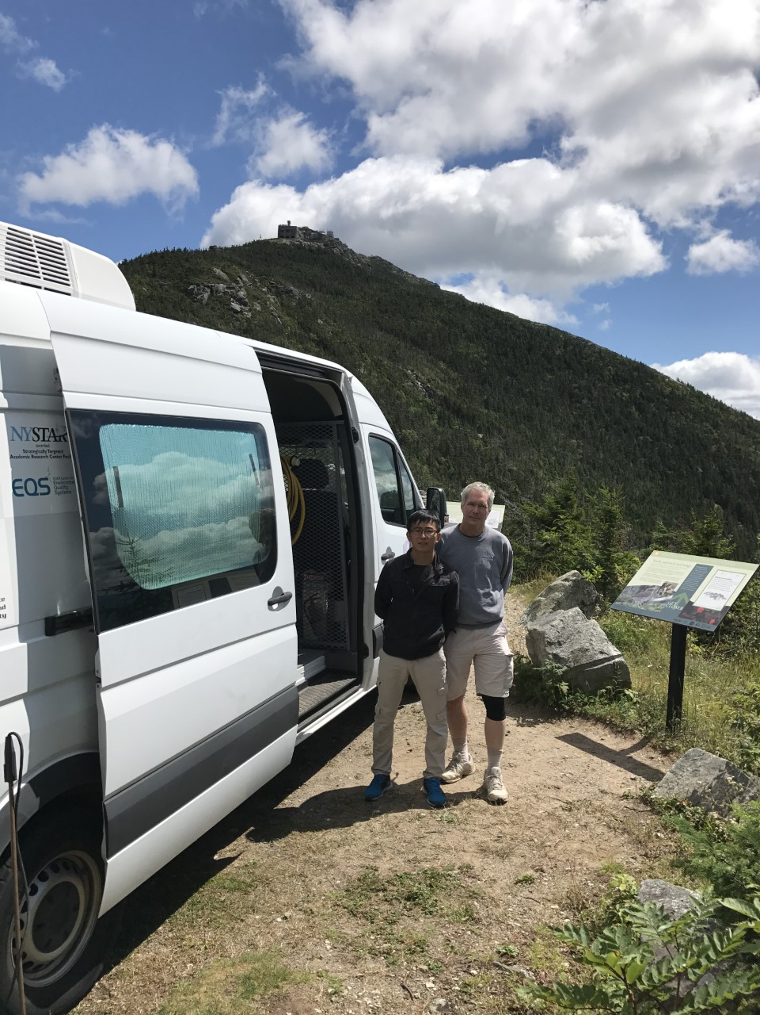
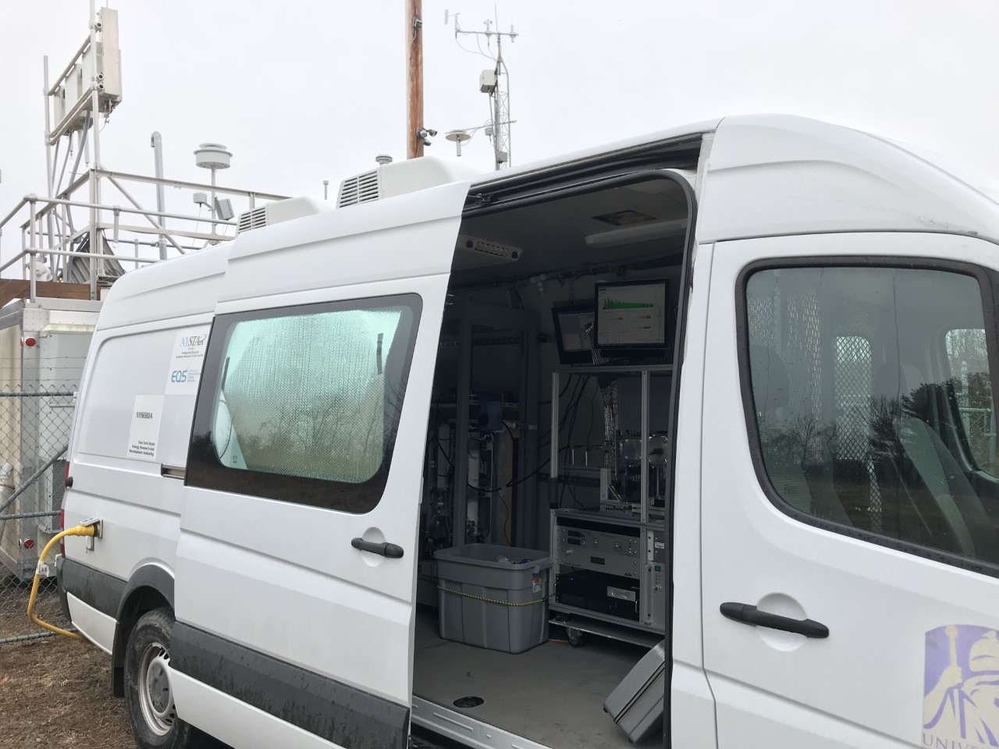
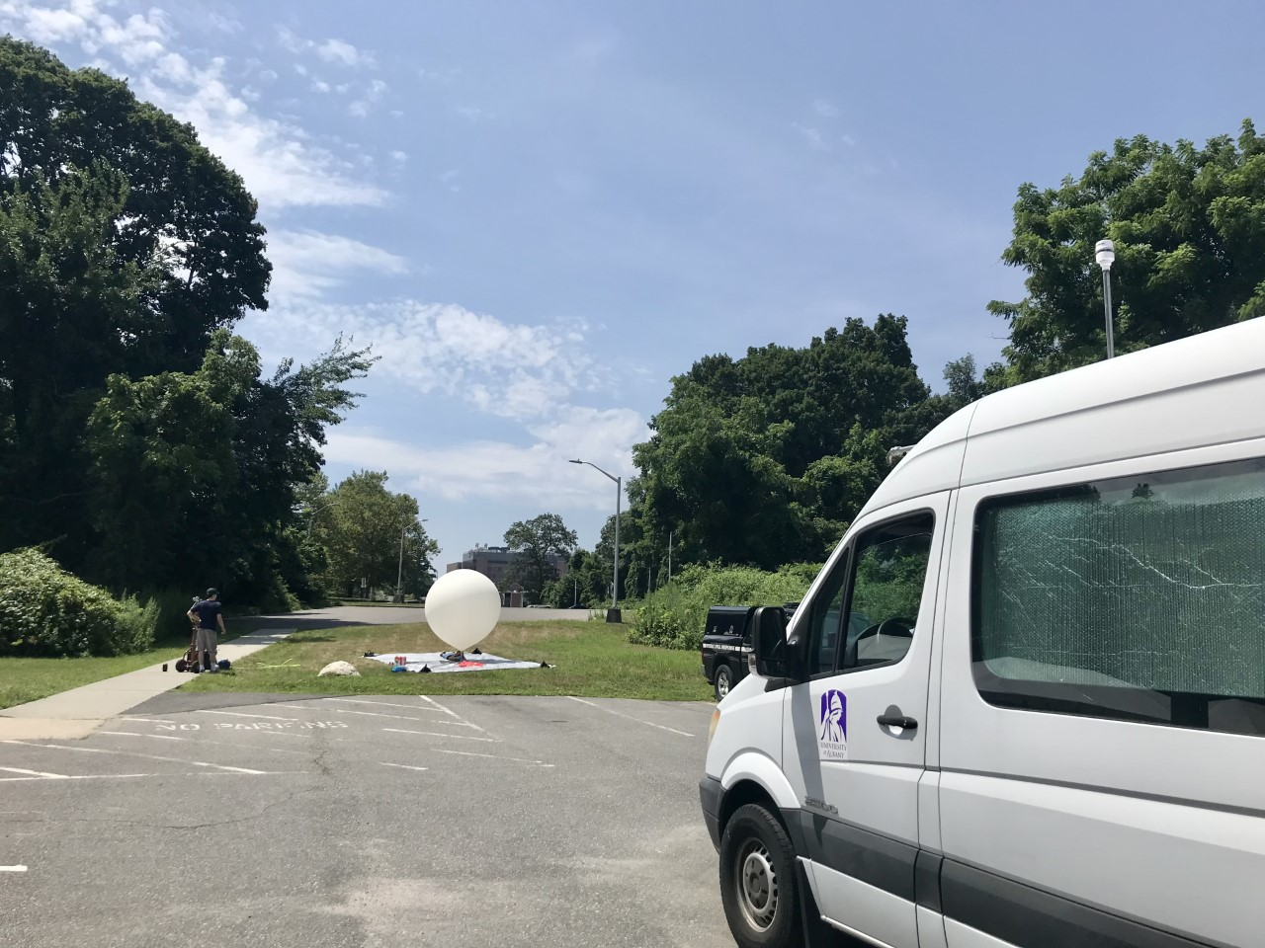
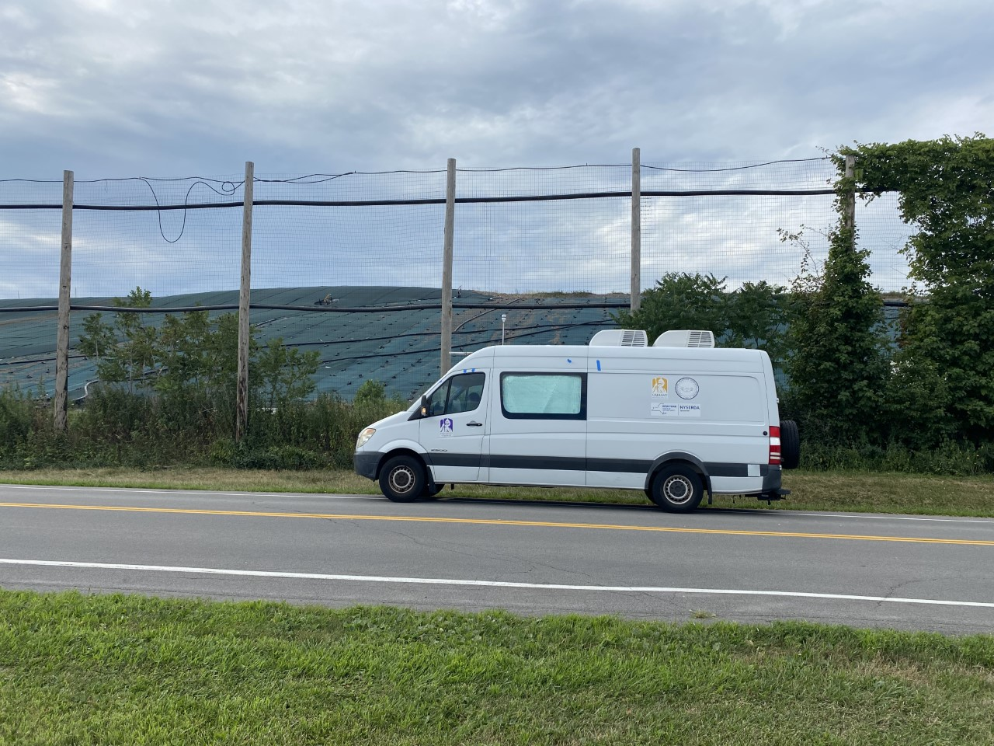
ASRC mobile lab
2007 Dodge Sprinter Van
8 Lithium ion batteries with a fully charged capacity of 13.25 KWh
Around 5-7 hour measurement deployments possible
Two inlets, one for gases, the other for aerosols
Flexible payload configuration
WFM, 2017
PSP, 2017/2018
LISTOS, 2018/2019
NYS-CH4, 2021/2022

Slide 4
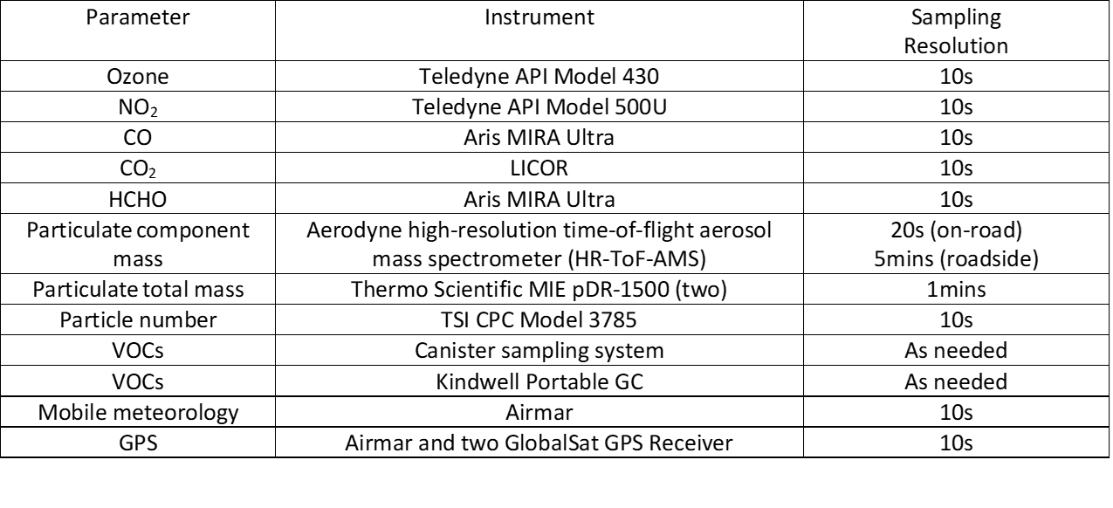
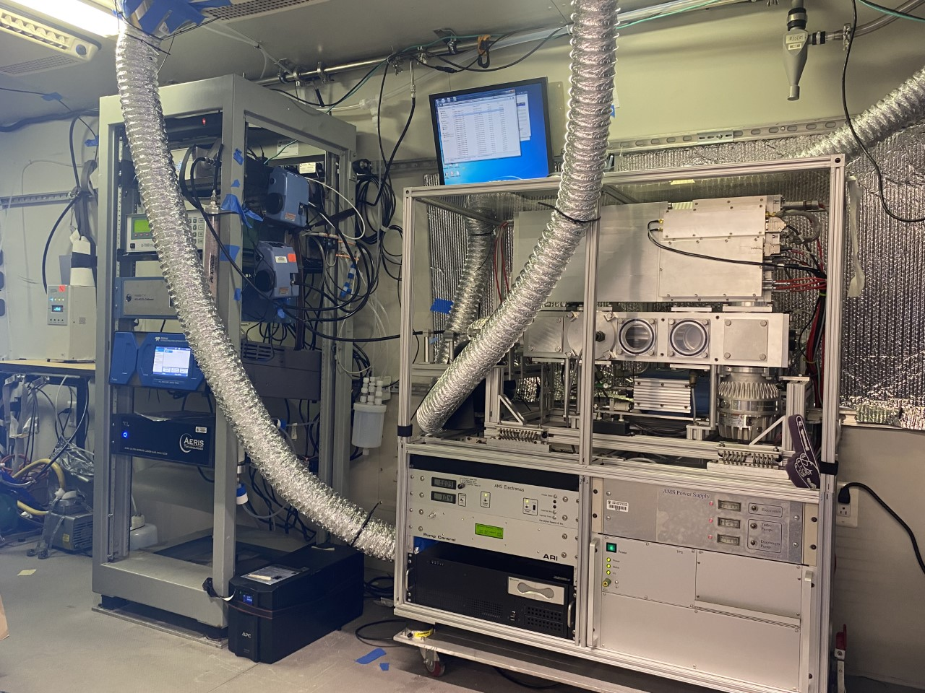
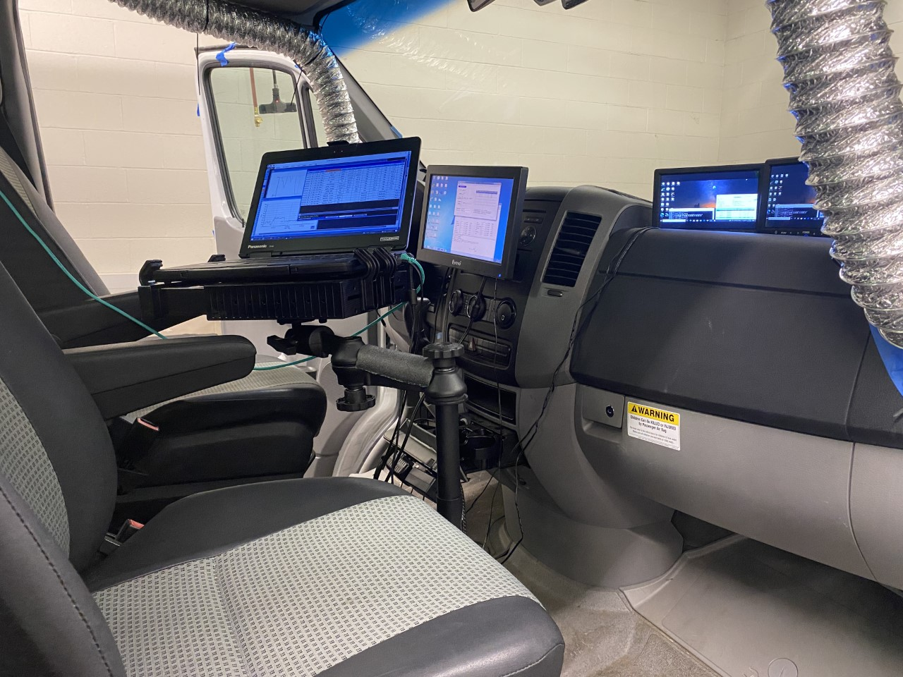

Measurement platform and Instruments

Slide 5
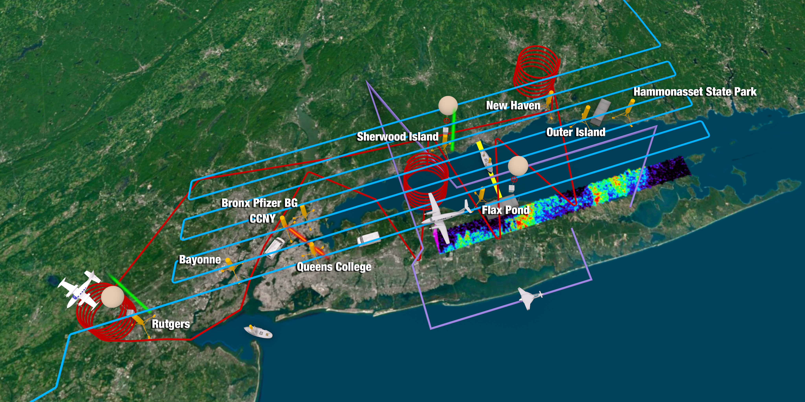
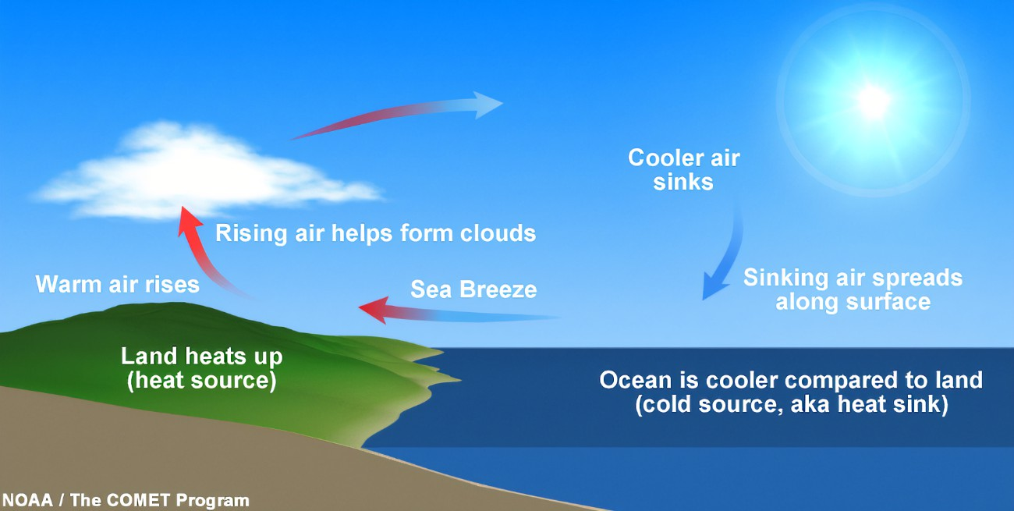
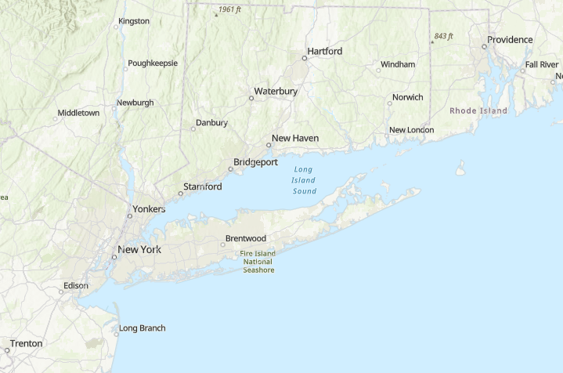
Connections-Atmospheric Chemistry and Boundary Layer Meteorology-sea breeze
2018 LISTOS

Slide 6
Schedule for this module
Lecture 1 - 02/13 Introduction and Stratosphere
Lecture 2 - 02/15 Tropospheric Gas Phase Chemistry
Lecture 3 - 02/20 Aqueous Phase Chemistry
Lecture 4 - 02/22 Atmospheric Chemistry of Aerosols
Lecture 5 - 02/27 Atmospheric Chemistry Measurements
Problem Set – Distributed 02/20, due 02/27

Slide 7
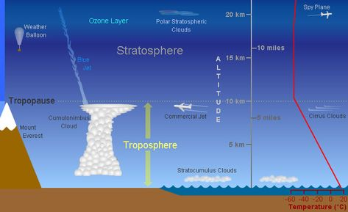
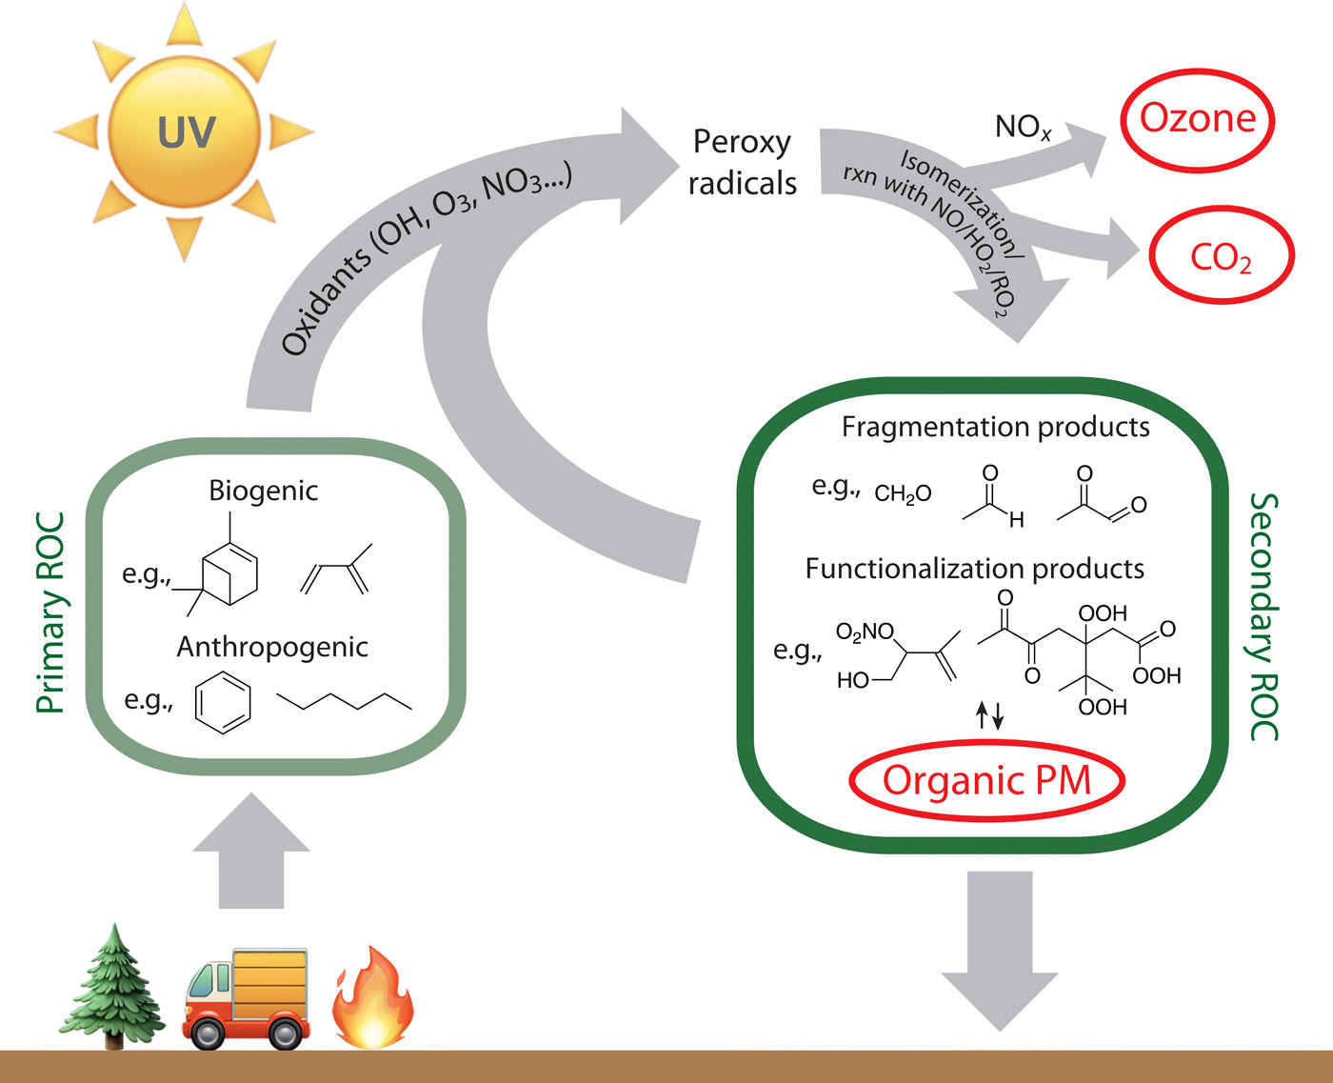
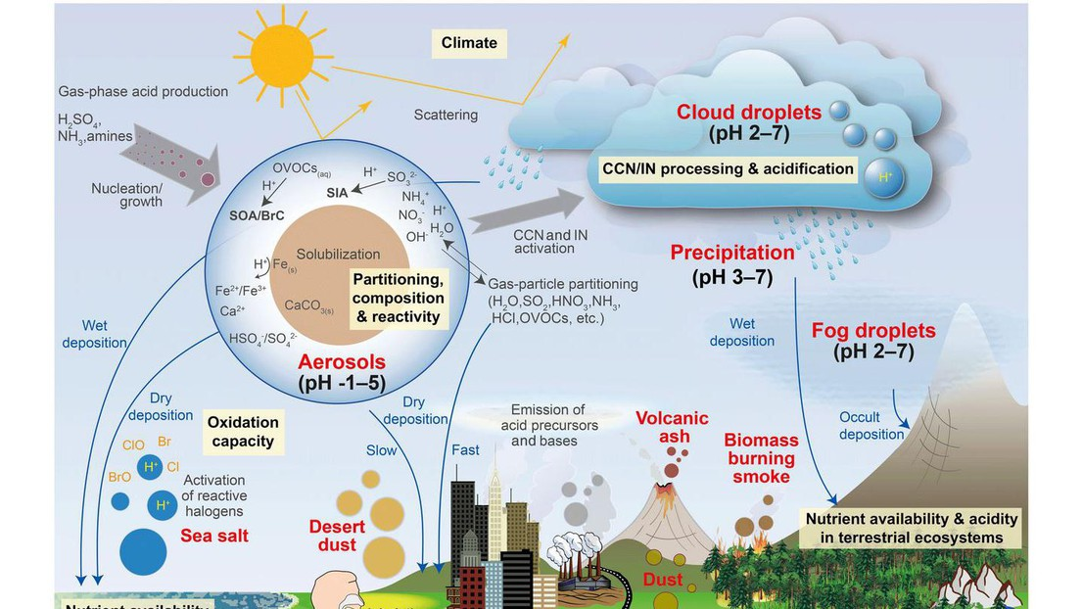
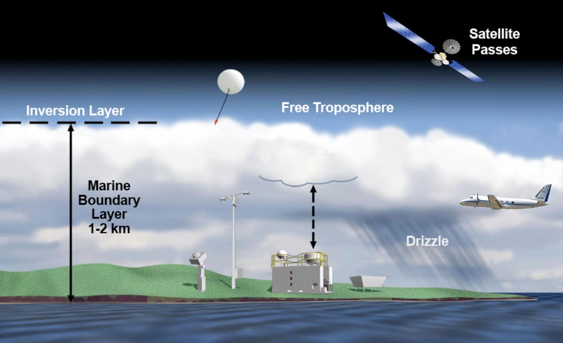
Unit Outline
1. Stratospheric Chemistry
2. Tropospheric Gas Phase Chemistry
3. Aqueous Phase Chemistry
4. Atmospheric Chemistry of Aerosols
5. Atmospheric Chemistry Measurements

Slide 8
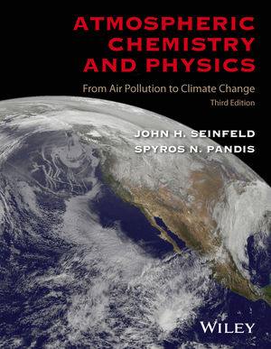

For those who like a “textbook” for a different perspective
“Introduction to Atmospheric Chemistry” by Daniel Jacob. Available online at https://acmg.seas.harvard.edu/education/introduction-atmospheric-chemistry. Esp. Chapters 9-13.
“Atmospheric Chemistry and Physics: From Air Pollution to Climate Change, 3rd Edition” by John H. Seinfeld, Spyros N. Pandis.

Slide 9
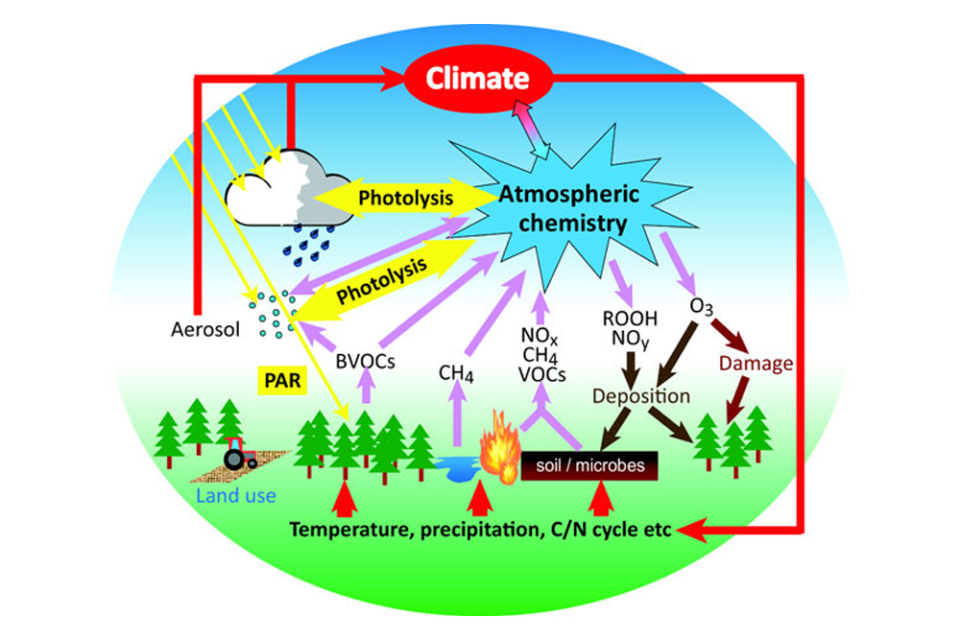
Atmospheric Chemistry
Study composition and chemistry of the atmosphere
More specifically, the sources, sinks, and transformations of reactive species
Reactive gases and particles are a very small fraction of the atmospheric mass (and volume)
How important can these “trace” reactive species be?

Slide 10
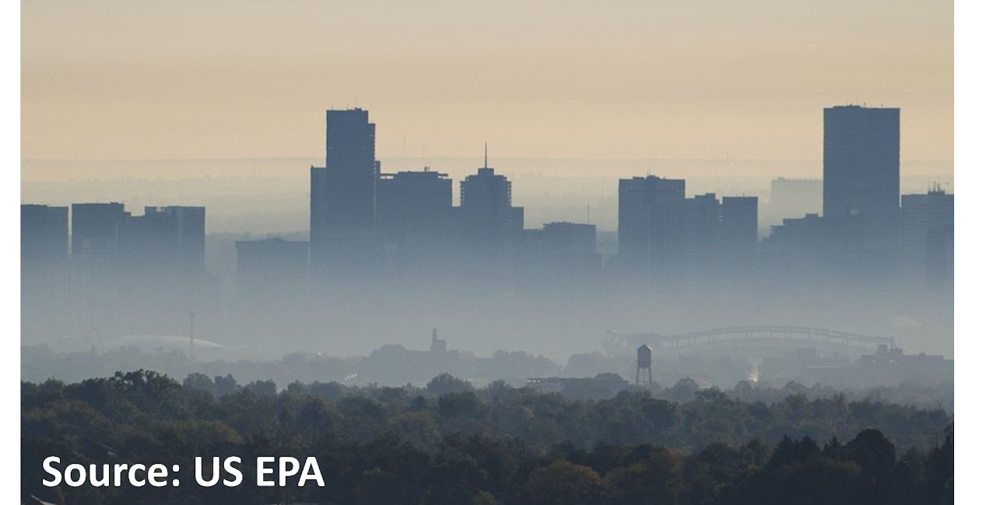
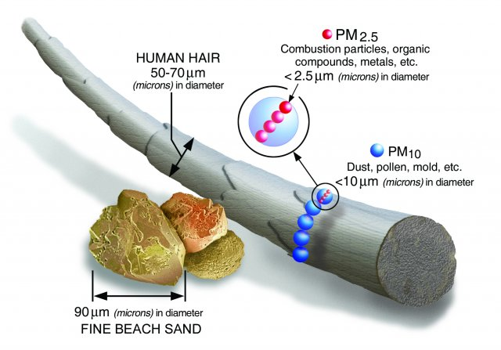
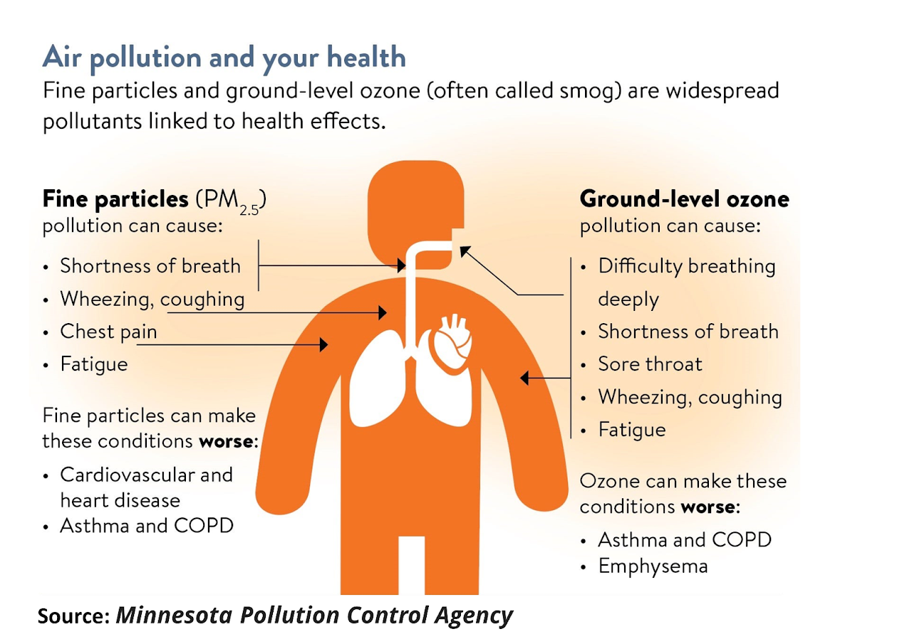
Examples of the Impact of Chemistry-air pollution
Ozone, mainly in the stratosphere, has a mixing ratio up to about 10 ppmv, but makes human life on the surface possible by absorbing nearly all harmful UV radiation.
Surprisingly, Ozone at the surface, with a mixing ratio typically less than 0.1 ppmv, is harmful to humans (EPA Standard: maximum 8-hour concentration < 70 ppb)
Particulate Matter (PM or aerosols) at the surface, is also harmful to human health, especially PM_{2.5}/PM₁. (EPA Standard: 24-hour PM_{2.5} standard to 35 μg/m³)
Other impacts on Climate, Acid Rain, ecosystem damage, etc.

Slide 11
Concentrations vs. Mixing Ratios
Concentration is the amount or number per unit volume
Absolute concentrations are required for all calculations (i.e., modeling activities)
Square brackets [] are used to designate concentration.
For aerosols (or particulate matter - PM) the unit is micrograms/m³ or µg/m³
Mixing ratio (or relative concentration, also mole fraction) is defined as moles for X per mole of air
ppmv (10⁻⁶ mol/mol) and ppbv (10⁻⁹ mol/mol) are frequently used for the trace gases we are interested in
(Using ideal gas law (and molecular weights for PM), one can convert between these units)

Slide 12
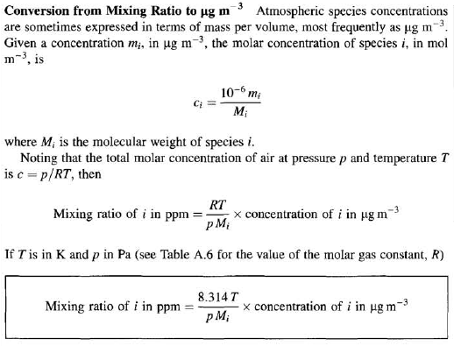
Concentrations vs. Mixing Ratios (cont.)
“Atmospheric Chemistry and Physics, chapter 1”
Using ozone as an example….

Slide 13
1. Stratospheric Chemistry
1.1 Stratospheric introduction
1.2 Stratospheric Ozone vertical profile
1.3 Stratospheric ozone formation and loss
1.4 Antarctic Ozone Hole

Slide 14
1.1 Stratospheric introduction
Extends from 10-15 km to ~ 50 km
  At 15 km, T ≈ 210-220 K, p ≈ 100 mbar ⇒ [M] ≈ 3.4x10¹⁸ molecules cm⁻³
  At 50 km, T ≈ 270-280 K, p ≈ 1 mbar ⇒ [M] ≈ 2.64x10¹⁶ molecules cm⁻³
  [M] designates the total atmospheric gas concentration.
  Positive temperature gradient ⇒ vertically stable ⇒ molecules take years to diffuse from the bottom to the top of the stratosphere
Key constituent and focus for our analysis is Ozone

Slide 15
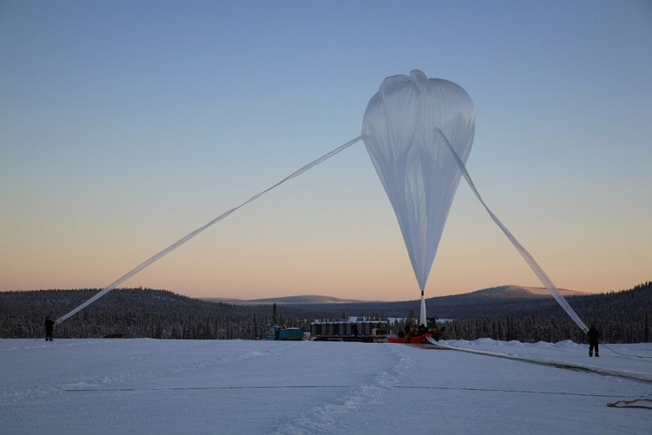
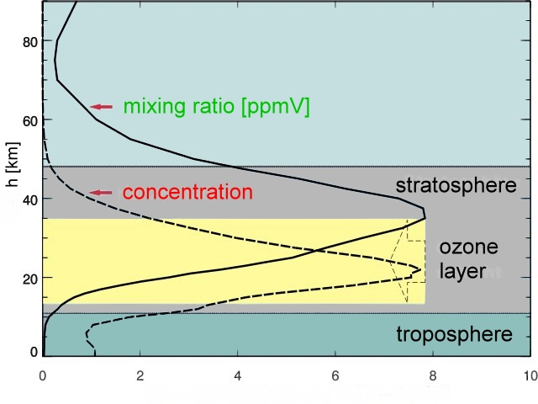
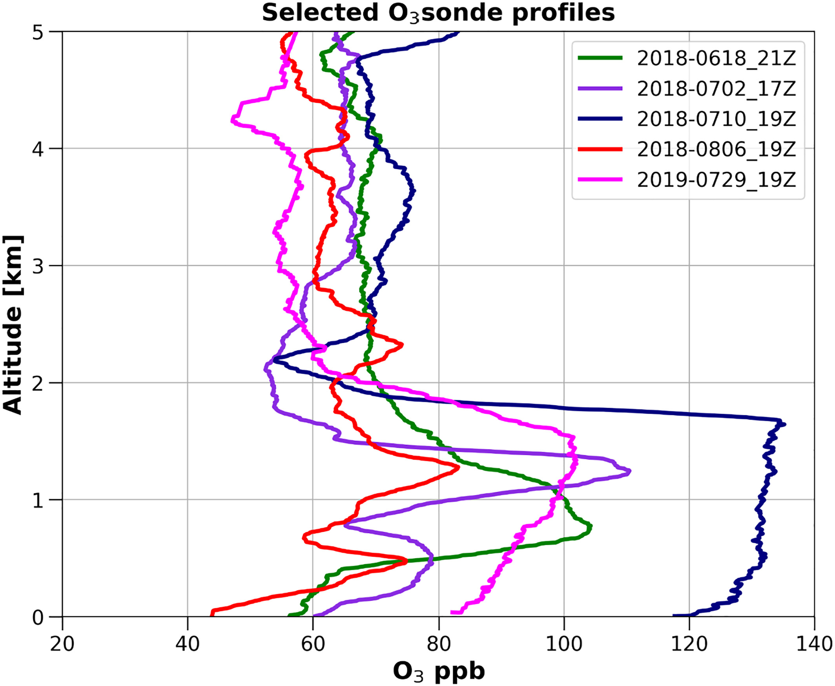
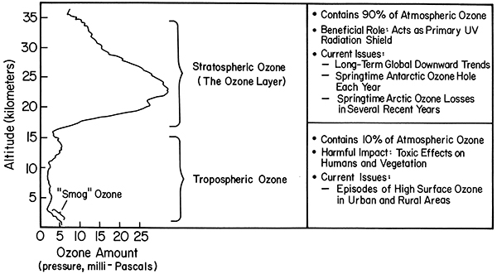

1.2 Stratospheric Ozone vertical profile
Q: How does the profile look like?

Slide 16
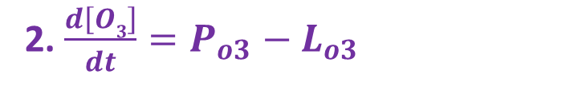
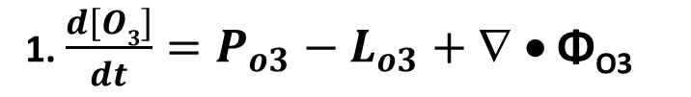
1.3 Stratospheric ozone formation and loss
Ozone Continuity Equation
1. $\frac{d\left[O3\right]}{dt}=P_{o3}−L_{o3}+\text{∇ • }\text{Φ}\text{O}\text{3}$
where Φ_{O3} is the (vector) O₃ flux, which describes the transport of O₃ within as well as in and out of the domain of interest. Very often in the middle and upper stratosphere the chemical lifetimes of the species of interest are sufficiently short (compared to the transport timescales) that we have a situation of “photochemical steady state” and can write
2. $\frac{d\left[O3\right]}{dt}=P_{o3}−L_{o3}$
This describes a balance between production and loss. A complete stratospheric model includes transport, but we will only focus on the chemistry.

Slide 17
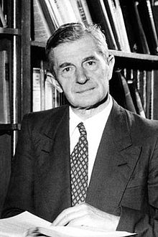
Chapman Mechanism for Ozone in the Upper Atmosphere (~1930)
1.3 Stratospheric ozone formation and loss
R1. O₂ + hγ → O + O; k₁ – photolysis (Production)
R2. O + O₂ + M → O₃ + M; k₂ – termolecular
R3. O₃ + hγ → O₂ + O(³P); k_{3a} – photolysis (Cycling)
→ O₂ + O(¹D); k_{3b} – photolysis
R4. O + O₃ → O₂ + O₂; k₄ – bimolecular (Loss)
[M] designates the total atmospheric gas concentration
slow
R2
O₂
R1
O O₃
fast
R3
R4
Sydney Chapman
(1888-1970)
slow

Slide 18

Brief aside on rate equations
If “A” reacts with “B”, (A + B → C + D) we can measure (or calculate) a rate constant for the reaction, and the reaction rate is given by
$$−\frac{d\left[A\right]}{dt}=−\frac{d\left[B\right]}{dt}=κ_{A+B}×\left[A\right]×[B]$$
  [A] – concentration of molecule A
  -d[A]/dt – rate of loss or removal of A
  k_{A+B} – rate constant for reaction of A and B; rate constants are temperature and sometimes pressure dependent
  R = k_{A+B}× [A] ×[B] is the “rate” or “reaction rate” of the A + B reaction

Slide 19

Brief aside on rate equations (cont.)
For a termolecular reaction: A + B + C → products
$$−\frac{d\left[A\right]}{dt}=−\frac{d\left[B\right]}{dt}={−\frac{d\left[C\right]}{dt}=κ}_{A+B+c}×\left[A\right]×[B]×[C]$$
For a unimolecular reaction, or a photodissociation reaction: A → products
$$−\frac{d\left[A\right]}{dt}=κ_{A}×\left[A\right]$$

Slide 20
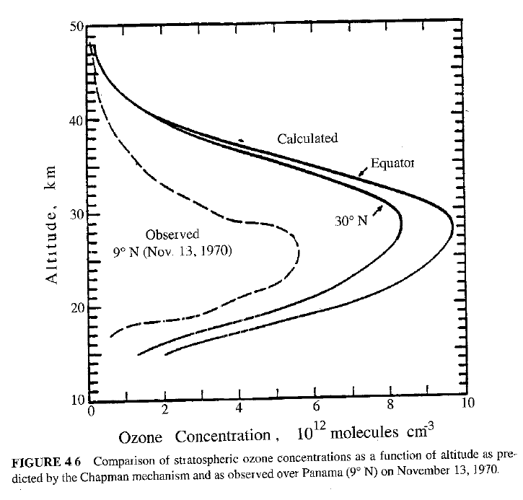
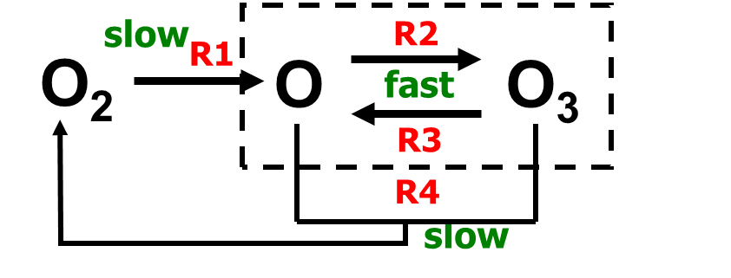
1.3 Stratospheric ozone formation and loss
Chapman mechanism gets the shape right, but not the magnitude.
Missing some？
Why is ozone lower than Chapman predicts?

Slide 21
Enter Catalytic Reaction Cycles
1.3 Stratospheric ozone formation and loss
In a catalytic cycle there is no net effect on the catalytic species
Simplest examples look like
  X + O₃ → XO + O₂
  XO + O → X + O₂
  NET: O + O₃ → 2O₂
But there is net loss of O_{x} (i.e., O₃)
Catalytic cycles reduce the ozone concentration
X in the above chemical equations (the catalyst) is a free radical like NO, OH, Cl, Br, etc.
*Free radicals are short-lived, highly reactive species that drive the chemistry they have one or more unpaired electrons

Slide 22
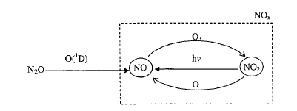
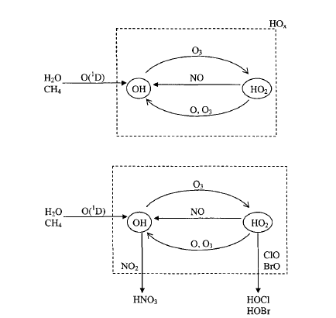
1.3 Stratospheric ozone formation and loss
1. Nitrogen oxide (NOX=NO+NO2) cycles
2. Hydroxyl radical (HO_{X}=HO+HO2) Cycles

Slide 23
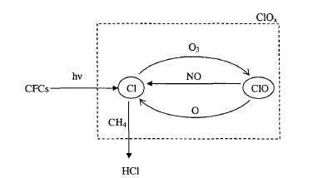
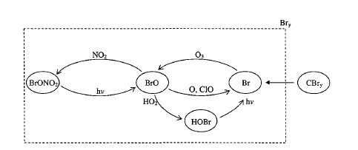
1.3 Stratospheric ozone formation and loss
3. HALOGEN CYCLES
3.1 Chlorine Oxide Radicals
(ClOx=ClO+Cl) Cycles
3.2 Bromine Cycles
Chlorofluorocarbons: seemingly benign gases have been emitted as a result of human activity and have unintentionally destroyed stratospheric ozone (talk later)

Slide 24
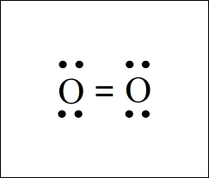
Some Basic Concepts:
1.3 Stratospheric ozone formation and loss
At its most basic level, one can consider the ozone balance in terms of breaking or making the O₂ bond
Breaking the O₂ bond – ozone production
Remaking the O₂ bond – ozone destruction
Atmospheric chemists often use “odd oxygen” (O_{x}=O+O3) which is the sum of ozone and oxygen atoms to simplify the algebra. Ozone makes up >99.9% of stratospheric odd oxygen, so in this context one can say the concentrations of ozone and odd oxygen are essentially equal.

Slide 25
Ozone Balance in the Mid- and Low-Latitude Stratosphere
1.3 Stratospheric ozone formation and loss
The following equation includes the most important, but not all, ozone loss processes – expressed in terms of odd oxygen:
  d[O_{X}]/dt =2 k_{O2} [O₂]
  -2 k_{O+O3} [O][O₃] -2 k_{O+NO2} [O][NO₂]
  -2 k_{O+ClO} [O][ClO]
  -2 k_{O+HO2} [O][HO₂]
  -2 k_{O+BrO} [O][BrO]
  -2 k_{O3+HO2} [O₃][HO₂]
Production
Losses

Slide 26
Take Home Points so far:
1.3 Stratospheric ozone formation and loss
Ozone is concentrated in the stratosphere due to high levels of UV radiation
There is a balance (or competition) between production (O₂ photodissociation) and chemical loss processes which establish the observed ozone concentration profile.
Catalytic cycles involving free radicals increase the loss rate and lower ozone concentrations
Seemingly benign gases have been emitted as a result of human activity (CFCs) and have unintentionally destroyed stratospheric ozone

Slide 27
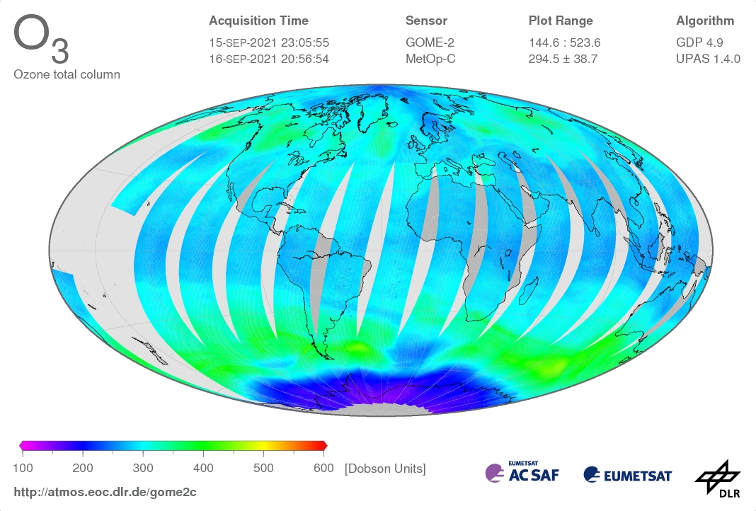
1.4 South Polar Ozone Loss
The Antarctic Ozone Hole was first reported in 1985.
This geographically (polar vortex region) and seasonally (austral spring) specific phenomenon has occurred regularly (austral spring) since then
Totally unexpected! (At the time)
Widely considered to have been the deciding impetus for the Montreal Protocol on Substances that Deplete the Ozone Layer (a major international environmental success story)
Ozone hole!

Slide 28
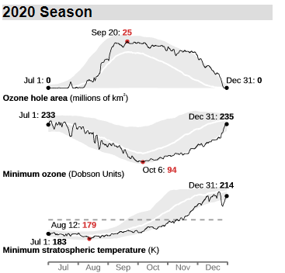
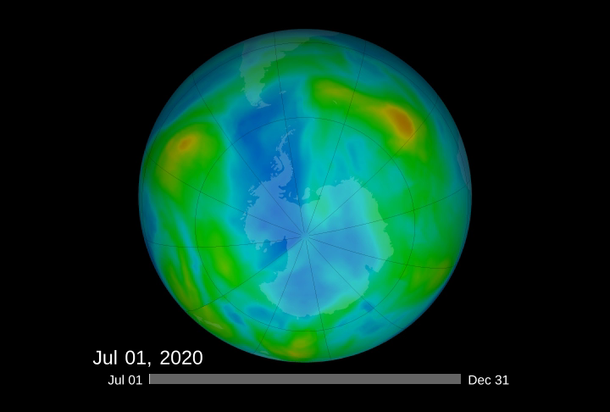
Ozone hole is a seasonal phenomenon it develops in austral spring (September-October) and is gone by December
1.4 South Polar Ozone Loss
Isolated concentric region around Antarctic continent is called the polar vortex.
Strong westerly winds, little meridional transport
http://ozonewatch.gsfc.nasa.gov/

Slide 29
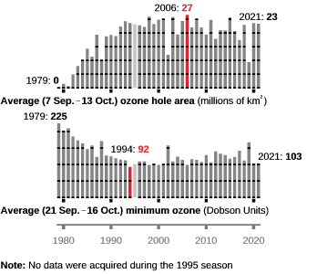
1.4 South Polar Ozone Loss
Area
Minimum Ozone
Satellite measurements.
https://ozonewatch.gsfc.nasa.gov/SH.html
Note: Dobson Units are column densities – 1 DU = 2.69x10¹⁶ molecules cm⁻².
300 DU is a 3 mm column of ozone at STP.

Slide 30

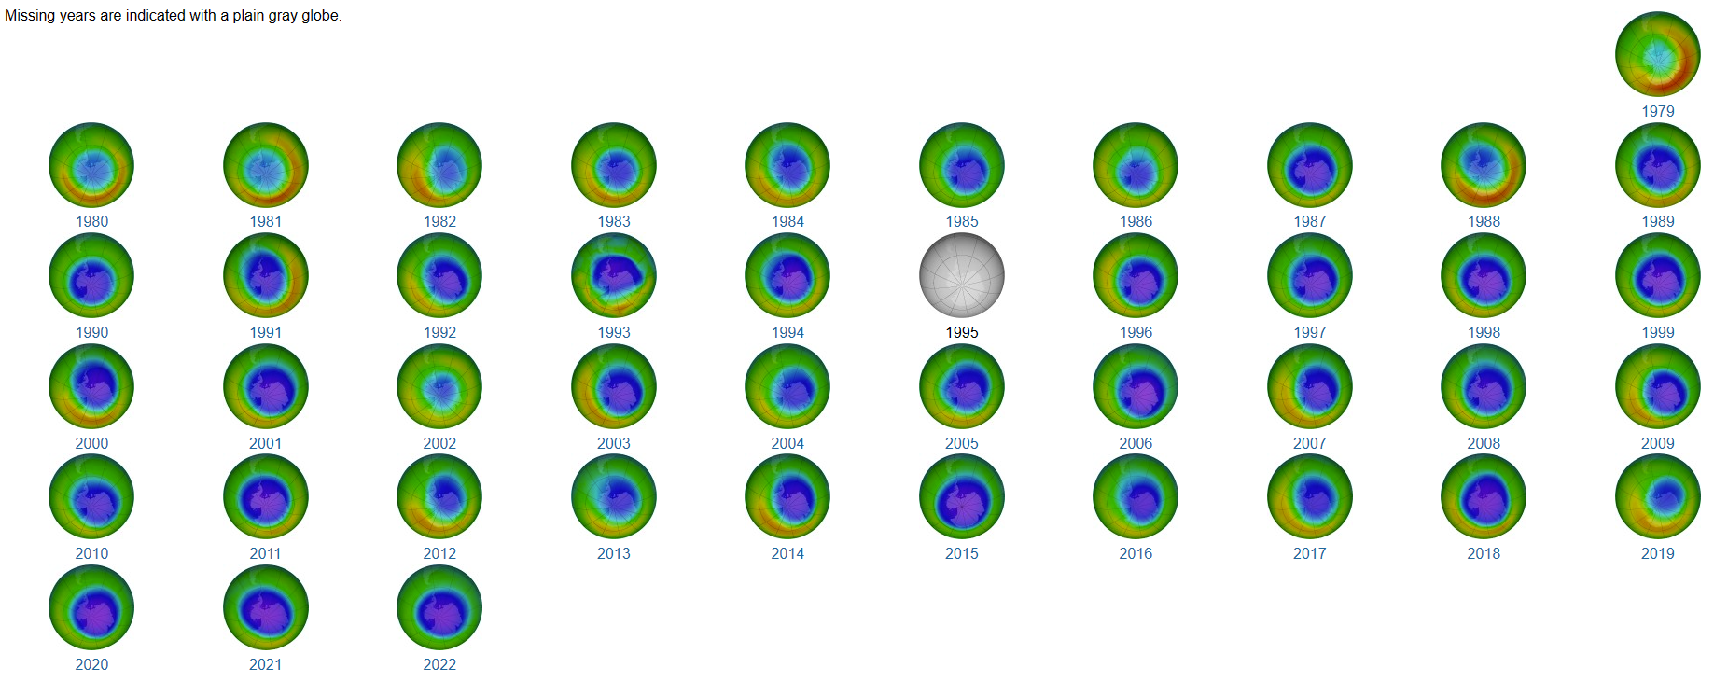
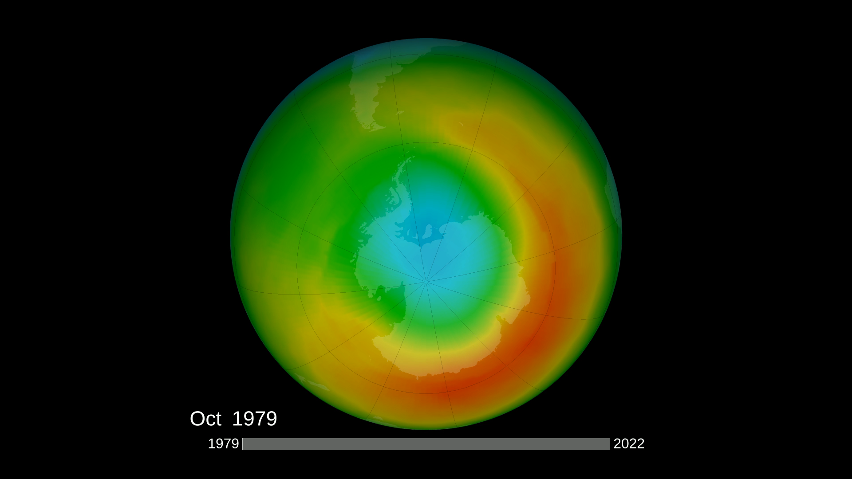
1.4 South Polar Ozone Loss
October Monthly Means (satellite data)
Note that there were Stratospheric Sudden Warmings (SSW) in 1988, 2002, and 2019.
https://ozonewatch.gsfc.nasa.gov/monthly/climatology_10_SH.html

Slide 31
What did the first observations show?
1.4 South Polar Ozone Loss
Balloon sondes in 1986 and 1987 showed that the depletion was not uniform, nor was it “from the bottom up”. (∴ Not dynamics!)
Ozone was being destroyed most dramatically in the 12-22 km range, with little change above and below.
At some altitudes in this range, there were periods when nearly all of the ozone was “chewed up”.
Microwave ground-based measurements observed very large levels of ClO in the Antarctic stratosphere.

Slide 32
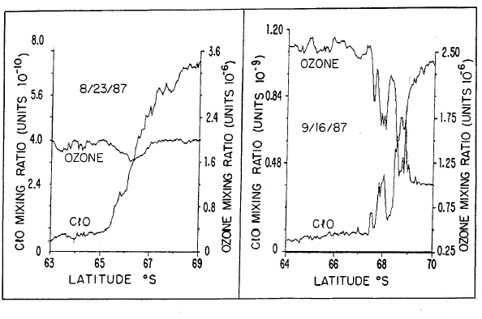
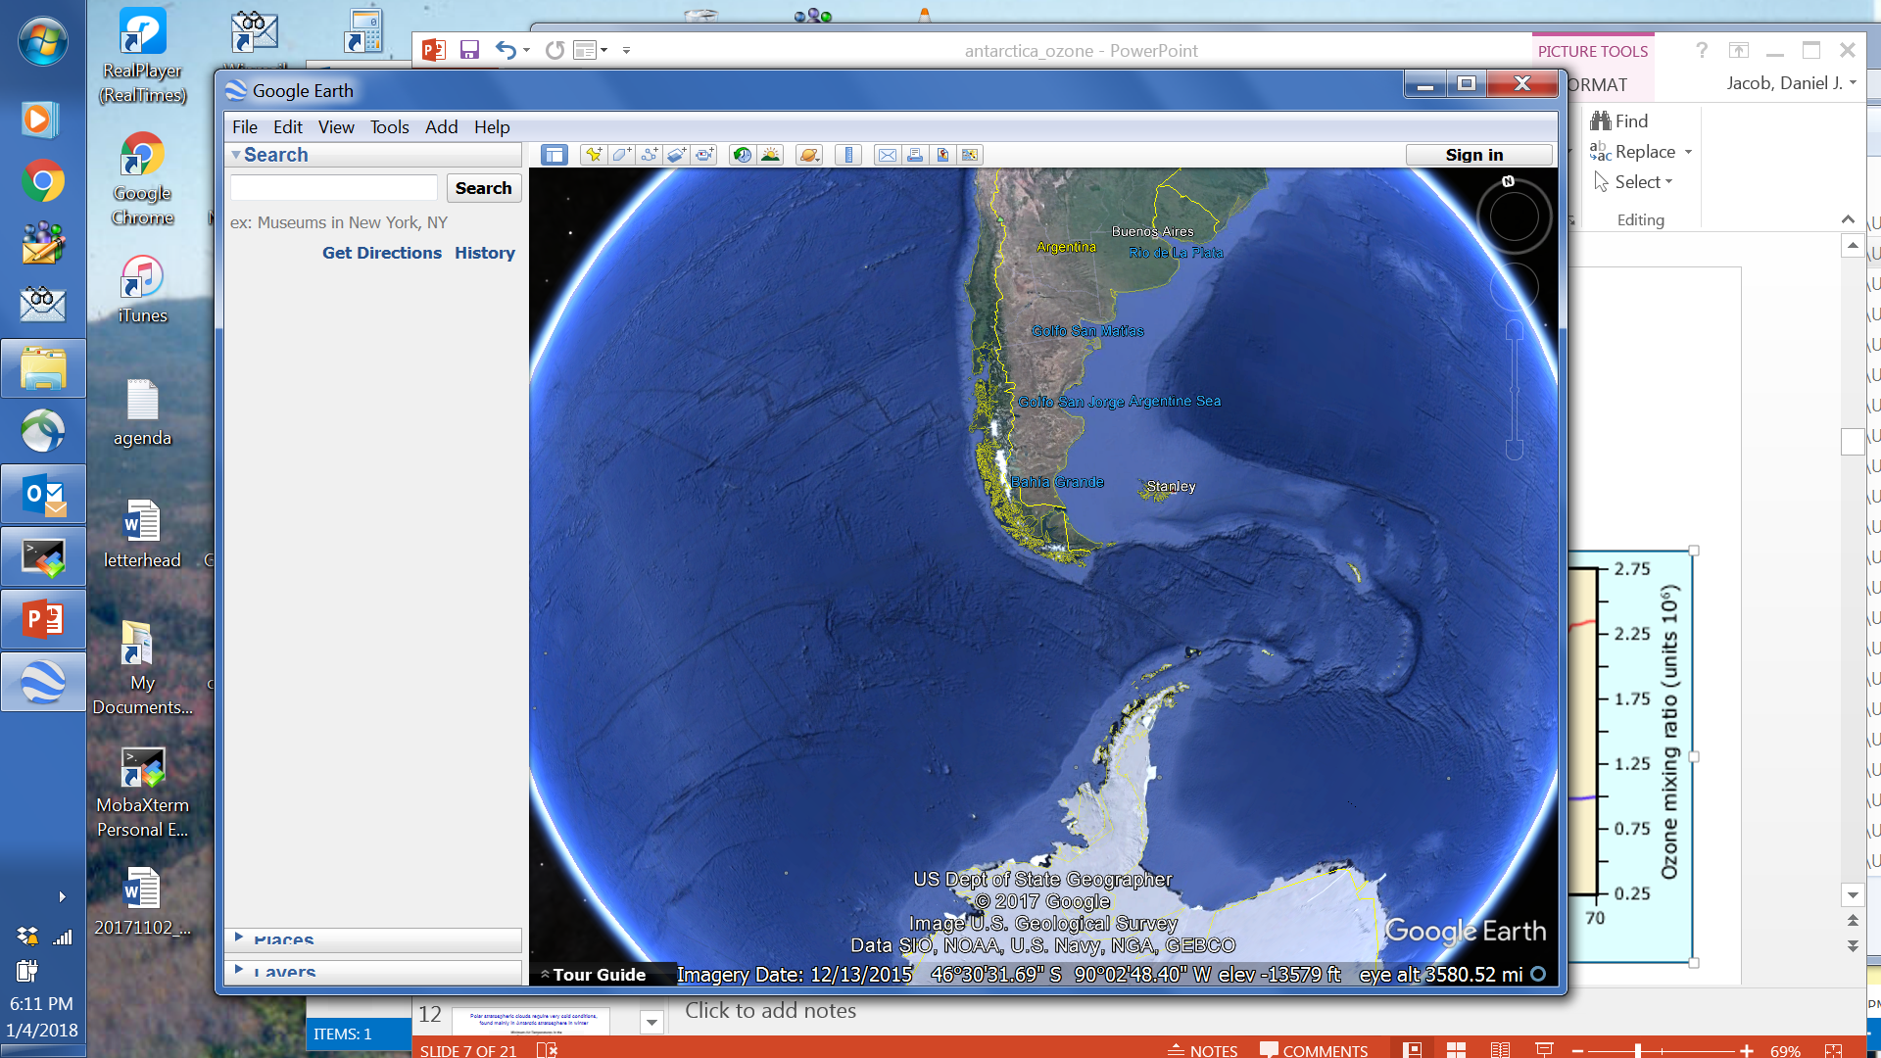
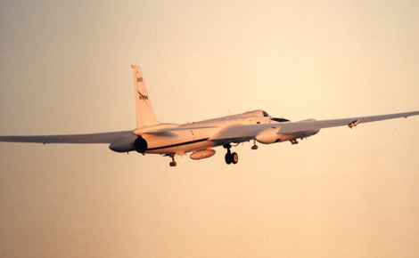
1.4 South Polar Ozone Loss
Very high ClO in ozone hole
NASA ER-2 aircraft flying in the lower stratosphere from Puenta Arenas, Chile to Antarctica
Outside vortex
Inside vortex
Outside vortex
Inside vortex
ozone
hole
boundary
Before Ozone Hole Formation
After Ozone Hole Formation

Slide 33
1.4 South Polar Ozone Loss
Balloon borne ozone profiles measured at South Pole: blue is the average of several profiles measured in September and October during 1967-1971 before the Antarctic ozone hole; red is on the day of the maximum ozone loss in 2001; green is the lowest total ozone recorded in 1986, the first year of CMDL's sounding program at the South Pole. Total column ozone is given in Dobson Units (DU) for each of the profiles.
Why?
WMO [2014]

Slide 34
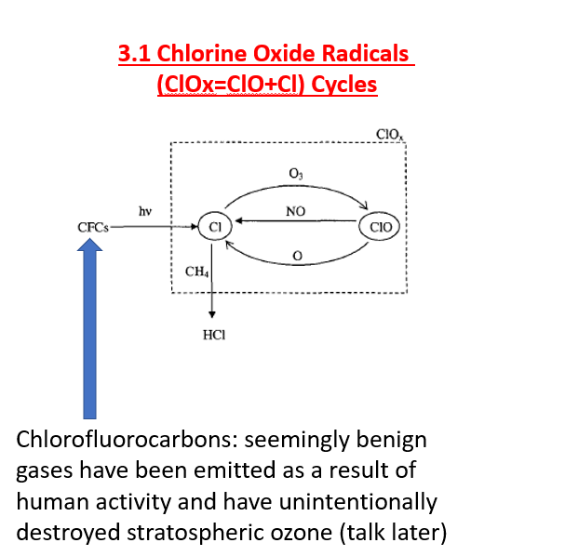
New Chemistry “At Play”
1.4 South Polar Ozone Loss
Reactions most important to this phenomenon
ClO dimer mechanism (Molina & Molina, 1987)
  ClO + ClO + M → ClOOCl + M
  ClOOCl + hγ → Cl + ClOO
  ClOO + M → Cl + O₂ + M
  2[ Cl + O₃ → ClO + O₂ ]
  NET: 2O₃ + hγ → 3O₂
Other reactions also contribute

Slide 35
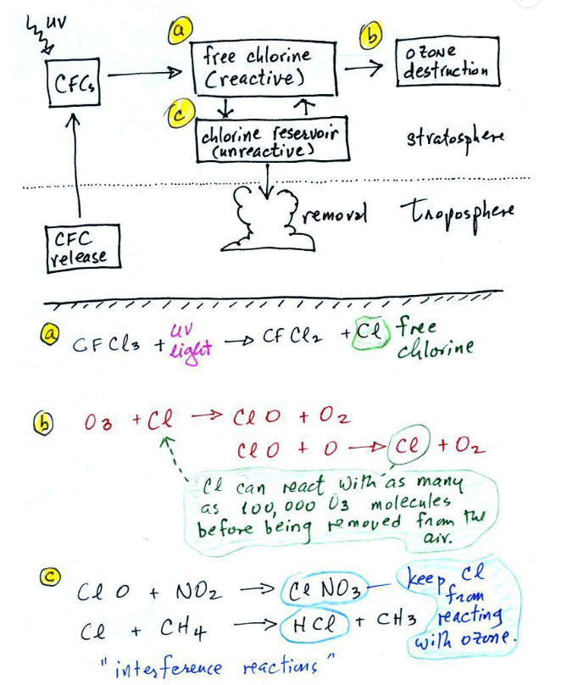
1.4 South Polar Ozone Loss
Question: But how does ClO reach to such high levels of concentration in Antarctic stratosphere with O3 hole in 12-22km?

Slide 36
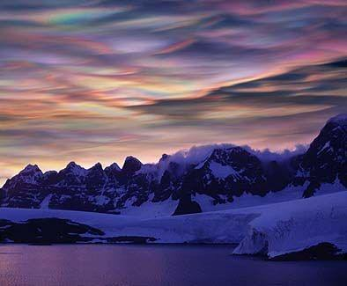
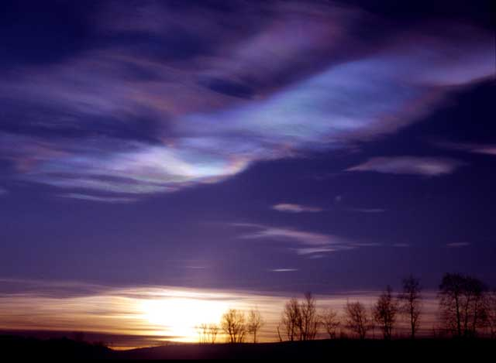
1.4 South Polar Ozone Loss
Polar stratospheric cloud (PSC)!!!

Slide 37
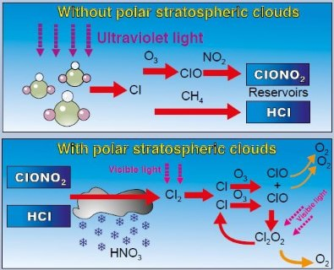
How and Why?
1.4 South Polar Ozone Loss
The keys to this phenomenon are
  Formation and persistence of Polar Stratospheric Clouds (PSCs) over the vortex region
  Reactions on the surfaces of these clouds that deplete reactive nitrogen and liberate reactive chlorine species
  This can continue as long as the vortex is intact and PSCs are present

Slide 38
Chlorine Liberation and Ozone Destruction
  ClNO₃ + HCl(s) → Cl₂ + HNO₃(s)
The ClNO₃ + HCl can proceed as long as the PSCs persist (days – weeks). When sunlight returns to the region
  Cl₂ + hγ → Cl + Cl (very fast)
  2[Cl + O₃ → ClO + O₂ ]
  2[ClO + NO₂ + M → ClNO₃ + M ]
  NET: HCl + 2 O₃ + 2 NO₂ → ClNO₃ + 2O₂ + HNO₃(s)
These reactions (I – IV) continue until either:
  HCl(s) is gone (used up) – pre-1979
  NO₂ is all converted (via ClNO₃) to HNO₃, at which point the ClO builds up and the Cl species are dramatically repartitioned and chew up ozone.

Slide 39
1.4 South Polar Ozone Loss
1. Formation of the polar vortex isolates the air over the continent from mixing with mid-latitudes, which amplifies
2. Very cold air temperatures, which allow
3. Formation of Polar Stratospheric Clouds (PSCs), which leads to
4. Surface reactions on the ice surfaces involving Clx and NOx;
5. At the end of polar night the sun returns, allowing
6. Liberation of active Cl (photolysis reactions), and de-nitrification (removal of HNO3 through gravitational settling)
7. Active Cl efficiently destroys ozone, mainly through ClO dimer catalytic cycle.
8. This produces an anticorrelation of O3 and ClO near the edge of the vortex;
9. Break-up of polar vortex allows the in-mixing of mid-latitude air and the return to “normal”

Slide 40

What is difference between north vs. south pole?
Much less than in Antarctica

Slide 41
The Future of Stratospheric Ozone
https://csl.noaa.gov/assessments/ozone/2018/twentyquestions/
“Twenty Questions” for discussions with friends and relatives, and/or use in outreach or educational activities
Globally, Ozone depletion has paused, and there are signs of recovery
Uncertainties remain (emissions, climate change, location, etc), but the timing of recovery is …

Slide 42


https://csl.noaa.gov/assessments/ozone/2022/

Slide 43



